Slide 1

SpaceX Flight Schedule Team Ronnie Zonder Ronnie -Daryl -Fabian -Calvin -Bartek -Frank -Tristan

Slide 2
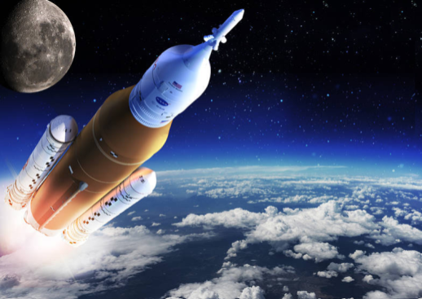
Inhoud
Opdracht
Features
Website demonstratie
Questions?

Slide 3
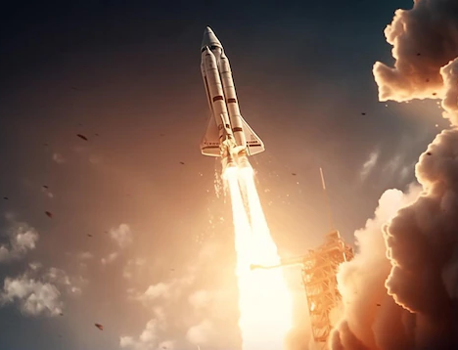
Opdracht
Onze keuze
Waarom hebben we SpaceX Flight Schedules gekozen?

Slide 4

Features
Calendar Interface
Maintenance window
Passenger Capacity Management
Repair Flights
Mobile-friendly

Slide 5

Website Demonstratie

Slide 6
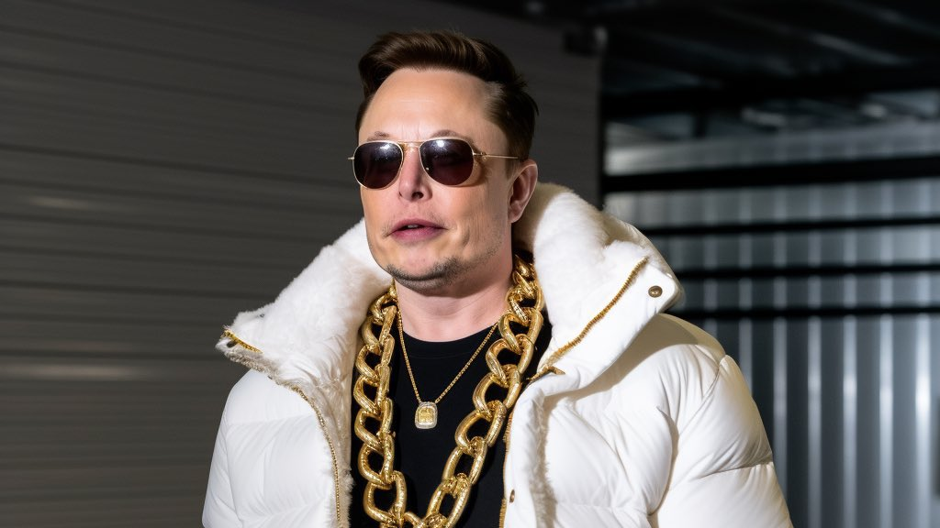
Questions?

